Slide 1
Bootcamp_Data Engineering Training
Prepared By,
Srimathi Chandrasekaran
31/05/2022

Slide 2
Chapter3: Spark Streaming & Lambda Architecture
Intro to Lambda Architecture => 31/05/2022
Spark streaming => 31/05/2022
Structured streaming
Apache Kafka
Structured streaming + Apache Kafka

Slide 3
Intro to Lambda Architecture
As the data sources grow and the veracity of the data increases, the enterprises have data from both operational systems (ERPs/CRMs) and real time sensors such as IOT and IIOT devices which can be internal or external.
There is also a growing need to process the data in real time for faster insights. Organizations that are re-architecting or re-engineering the analytics solutions on cloud are following familiar pattern of architecture that is called Lambda architecture.
Lambda Architecture provides the capabilities for the organizations to process the data used for analytics in both batch and real-time processing mode.
This is a framework which enables a beautiful harmony in the two processing layers and provide guidance on how to consume the data
Lambda architecture is a data-processing architecture designed to handle massive quantities of data by taking advantage of both batch and stream-processing methods.
This approach of architecture attempts to balance latency, throughput, and fault-tolerance by using batch processing to provide comprehensive and accurate views of batch data, while simultaneously using real-time stream processing to provide views of online data.

Slide 4
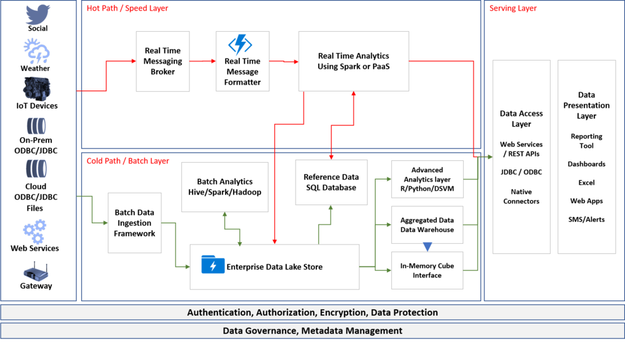
https://www.bing.com/videos/search?q=Intro+to+Lambda+Architecture&view=detail&mid=1B4AFA36EE565FD54B551B4AFA36EE565FD54B55&FORM=VIRE

Slide 5
Batch Layer (aka Cold Path)
The batch layer pre-computes results using a distributed processing system that can handle very large quantities of data. The batch layer aims at perfect accuracy by being able to process all available data when generating views.
Speed Layer (aka Hot Path)
The speed layer processes data streams in real time and without the requirements of fix-ups or completeness. Essentially, the speed layer is responsible for filling the “gap” caused by the batch layer’s lag in providing views based on the most recent data.
Serving Layer
Output from the batch and speed layers are stored in the serving layer, which responds to ad-hoc queries by returning pre-computed views or building views from the processed data.
I started this blog to write about the use of Databricks in Lambda Architecture, but I found it useful to cover this in a two part series. Please read the next post about “Lambda Architecture using Databricks”

Slide 6
Spark Streaming Architecture
https://www.bing.com/videos/search?q=spark+streaming&docid=608040148237881049&mid=92288D8A60E416EE3D2192288D8A60E416EE3D21&view=detail&FORM=VIRE
What is Spark Streaming?
Apache Spark Streaming is a scalable fault-tolerant streaming processing system that natively supports both batch and streaming workloads.
Spark Streaming is an extension of the core Spark API that allows data engineers and data scientists to process real-time data from various sources including (but not limited to) Kafka, Flume, and Amazon Kinesis.
This processed data can be pushed out to file systems, databases, and live dashboards. Its key abstraction is a Discretized Stream or, in short, a DStream, which represents a stream of data divided into small batches.
DStreams are built on RDDs, Spark’s core data abstraction. This allows Spark Streaming to seamlessly integrate with any other Spark components like MLlib and Spark SQL.
Spark Streaming is different from other systems that either have a processing engine designed only for streaming, or have similar batch and streaming APIs but compile internally to different engines.
Spark’s single execution engine and unified programming model for batch and streaming lead to some unique benefits over other traditional streaming systems.

Slide 7
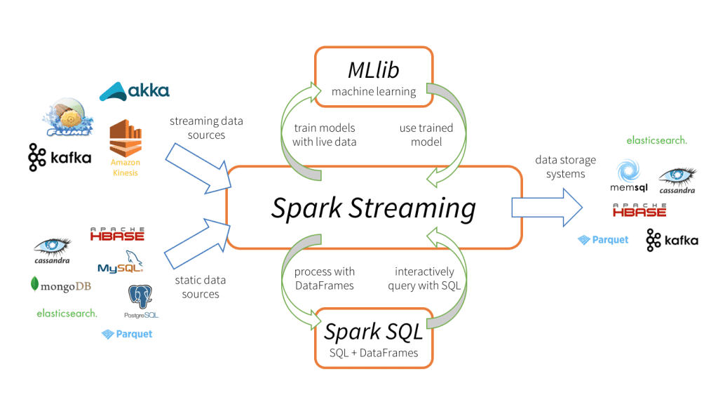
Four Major Aspects of Spark Streaming
Fast recovery from failures and stragglers
Better load balancing and resource usage
Combining of streaming data with static datasets and interactive queries
Native integration with advanced processing libraries (SQL, machine learning, graph processing)
This unification of disparate data processing capabilities is the key reason behind Spark Streaming’s rapid adoption. It makes it very easy for developers to use a single framework to satisfy all their processing needs.

Slide 8


Slide 9


